Slide 1

Important Spring Annotations
[BANG NGO]

Slide 2



@Autowired
Can be used to inject appropriate Spring bean into the application parts.
Three ways to use the annotation: Field-level, Method-level, Setter-level.

Slide 3
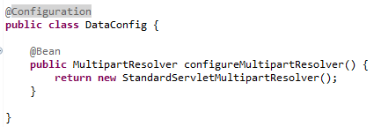
@Configuration
Mark a class as a source of the bean definition.
Is a component of the system that you want to wire together.
Methods must have the @Bean annotation to mark it as a bean producer.

Slide 4
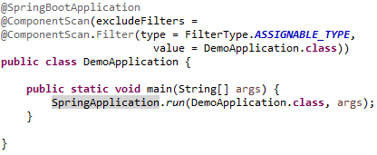
@ComponentScan
Leverage a normal Java class to a Spring bean.
Can be auto-scanned by the Spring Boot Application during the start-up time.
Can be used to inject wherever Spring framework need.

Slide 5

@Component
Leverage a normal Java class to a Spring bean.
Can be auto-scanned by the Spring Boot Application during the start-up time.
Can be used to inject wherever Spring framework need.

Slide 6
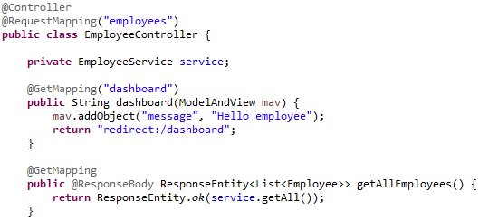
@Controller
Act as a normal @Component annotation and has the same functions.
In Spring MVC, we have to prepare data and give back to View.
Use @ResponseBody to enable automatic serialization of HttpResponse.

Slide 7
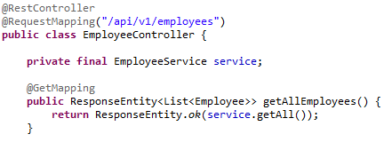
@RestController
Act as a normal @Component annotation and has the same functions.
Mainly use for RESTful API operations.
Don’t need @ResponseBody to enable automatic serialization of HttpResponse.

Slide 8
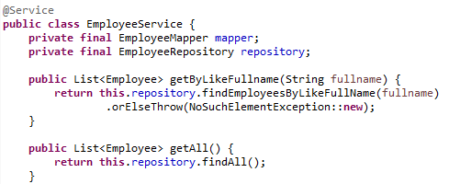
@Service
Act as a normal @Component annotation and has the same functions.
Annotates classes at the Service layer.
Holding business logic.

Slide 9

@Repository
Act as a normal @Component annotation and has the same functions.
Annotates classes at the Repository layer.
Responsible for providing CRUD Operations on Database tables.

Slide 10

Thank You!

